Slide 1
Demo 2
By Volodymyr Fufalko

Slide 2
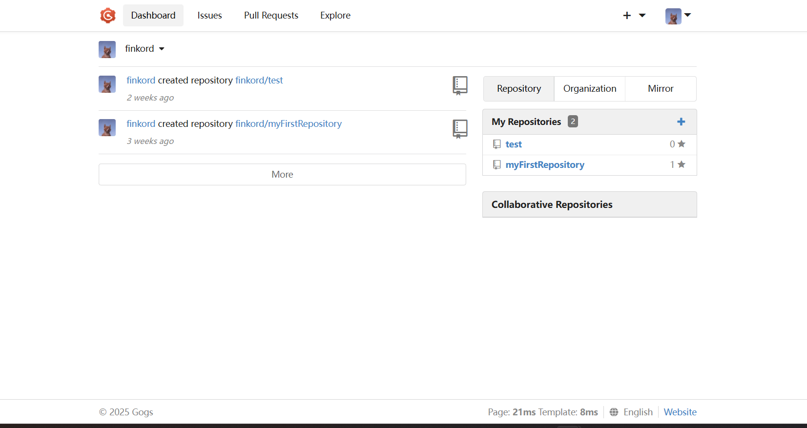

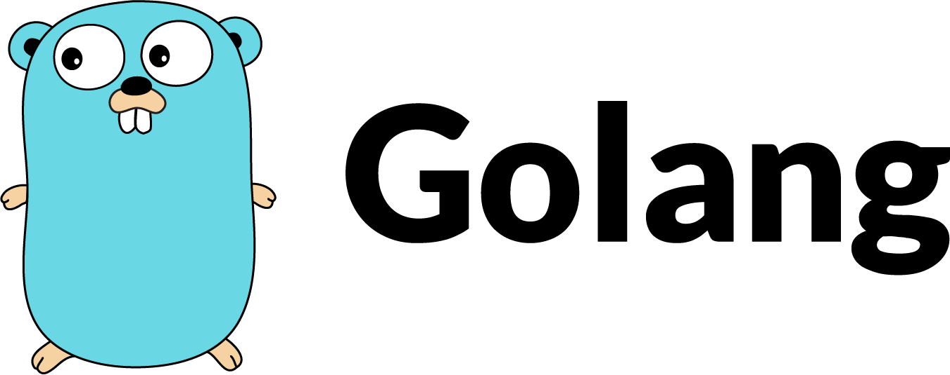
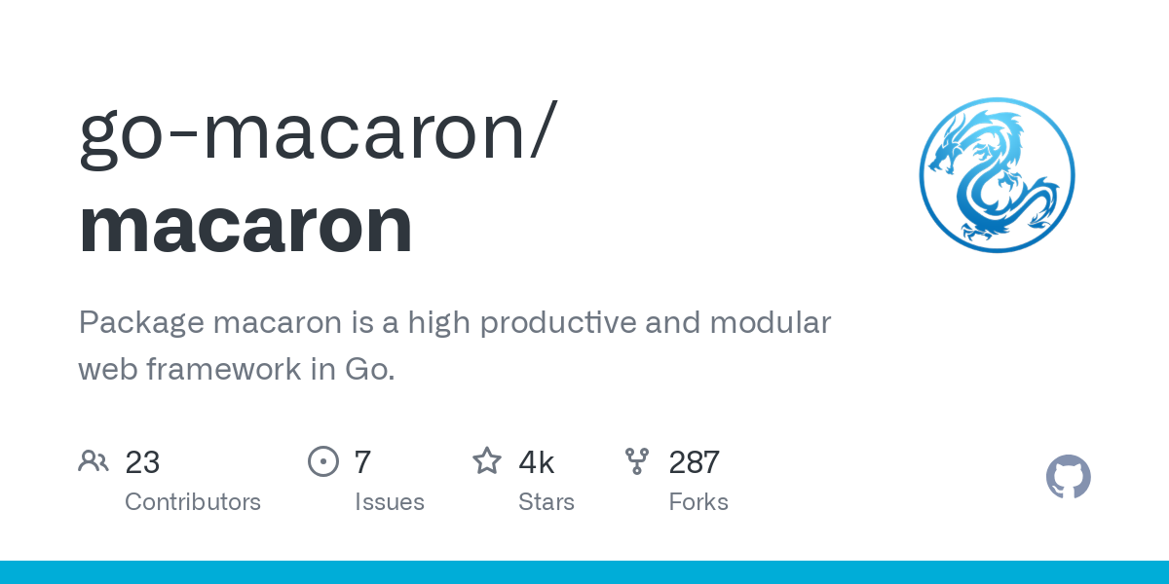
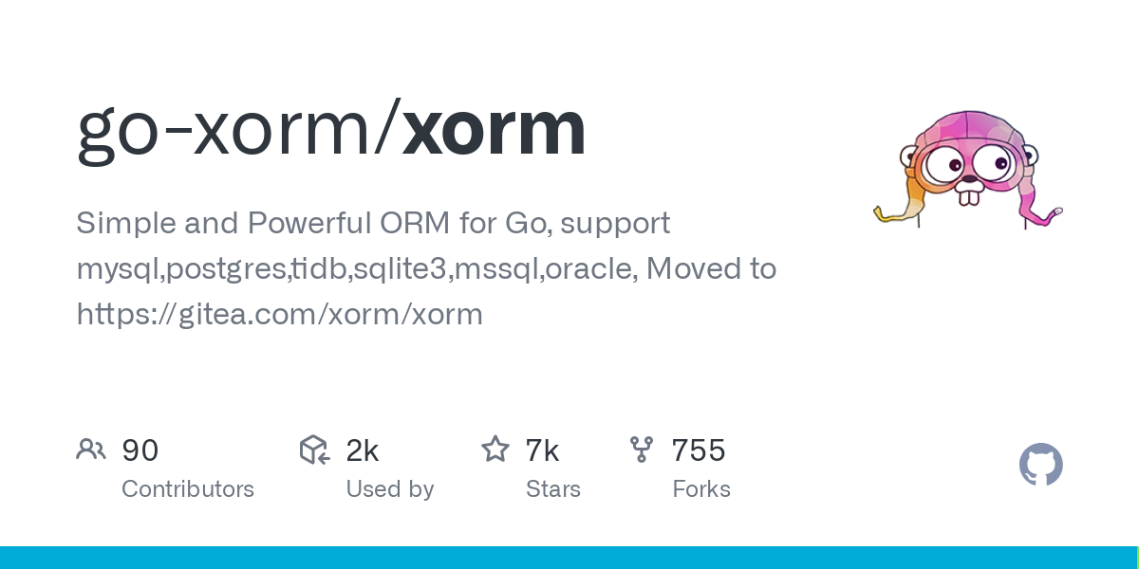
Project: GOGS (SELF-HOSTED GIT SERVICE)

Slide 3
Sprint 2 Tasks
By Volodymyr Fufalko

Slide 4
Second Sprint – Infrastructure & Automation with Docker
Create Dockerfile for Gogs
Create docker-compose.yml for full infrastructure
Configure postgres for Gogs backend
Configure nginx reverse proxy
Integrate OpenTelemetry Collector
Send metrics, logs, traces to Splunk Enterprise
Write multistage Jenkinsfile
Setup AWS ECR repository
Grant Jenkins access to ECR (IAM + CLI)
Containerize and configure SonarQube
Write sonar-project.properties
Configure Snyk CLI in Jenkins
Add Snyk token and config to Jenkins
Containerize ZAP with automation YAML
Write OpenTelemetry config
Create Splunk dashboards for Gogs observability
Inject OpenTelemetry auto-instrumentation into the Gogs application using go-autoinstrumentation

Slide 5
DIAGRAM
By Volodymyr Fufalko

Slide 6
